Slide 1
How to Help Craigs List their Instruments
J. Garrecht Metzger

Slide 2
What’s our big question?

Slide 3
What features help predict advertised prices on CraigsList?

Slide 4

“It’s shredimentary, my dear Rockson.”
-Me (just now)

Slide 5






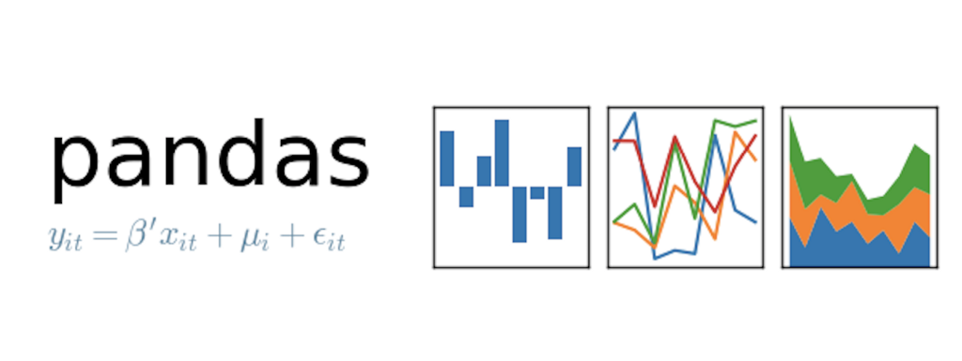
Tools

Slide 6
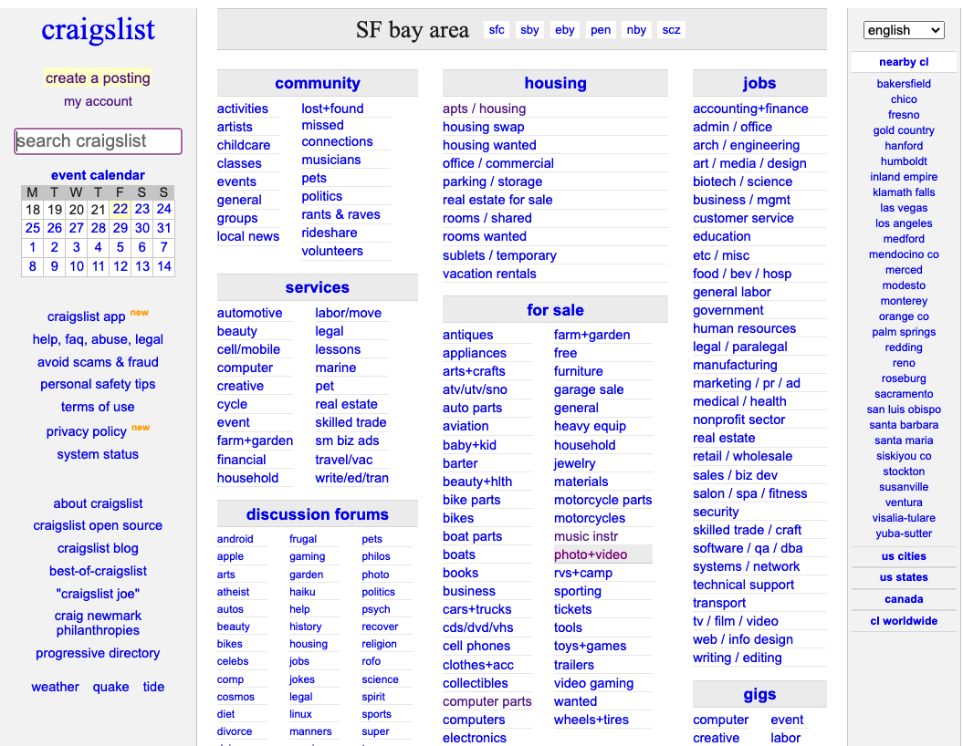

Slide 9
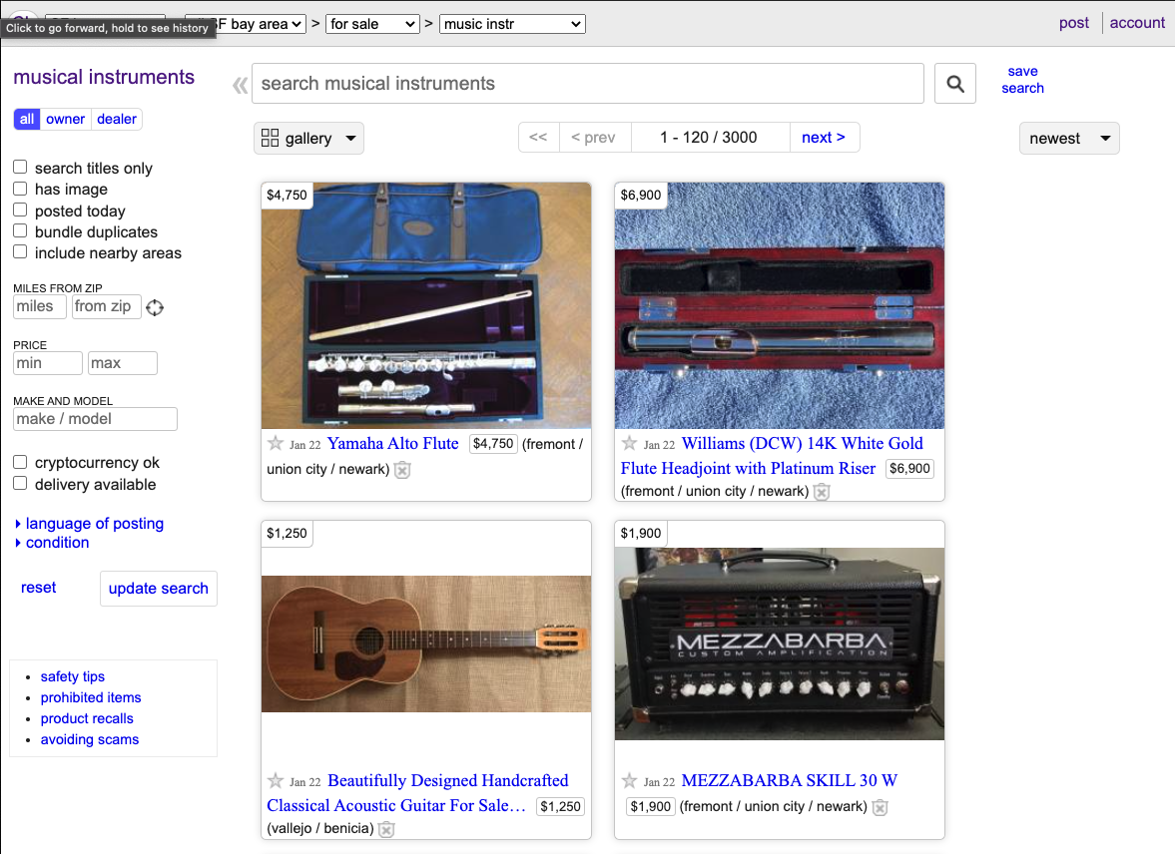

Slide 10
Target

Slide 11
Target
Price

Slide 12
Target
Features
Price

Slide 13
Target
Features
Price
Title length

Slide 14
Target
Features
Price
Title length
Day

Slide 15
Target
Features
Price
Title length
Day
Hour

Slide 16
Target
Features
Price
Title length
Day
Hour
Picture

Slide 17
Target
Features
Price
Title length
Day
Hour
Picture
Location*

Slide 18
Data Frame Results/Treatment
Maximum amount scraped: 2,880 posts
6 San Francisco Bay Area regions grouped together
3 days
2 ‘price’ outliers (crashed Seaborn)

Slide 19
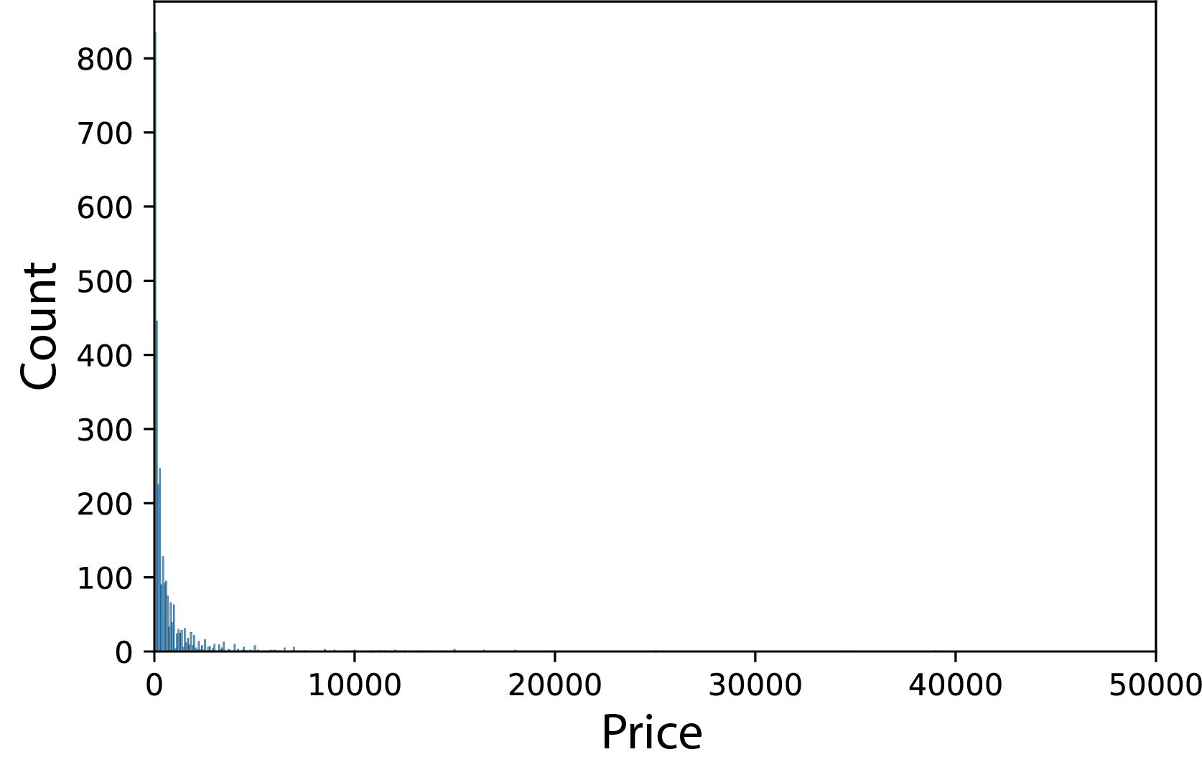

Slide 21
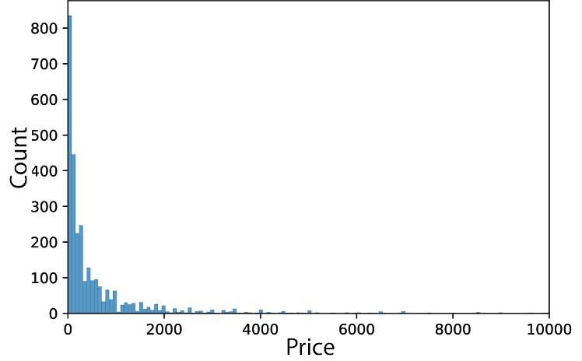

Slide 24
Mean = $685

Slide 25
Median = $200
Mean = $685

Slide 26
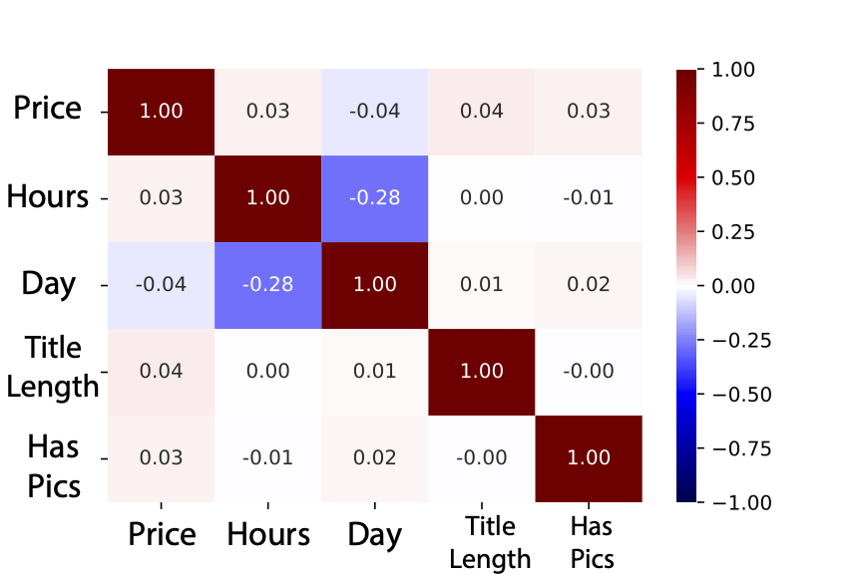
CORRELATIONS

Slide 27
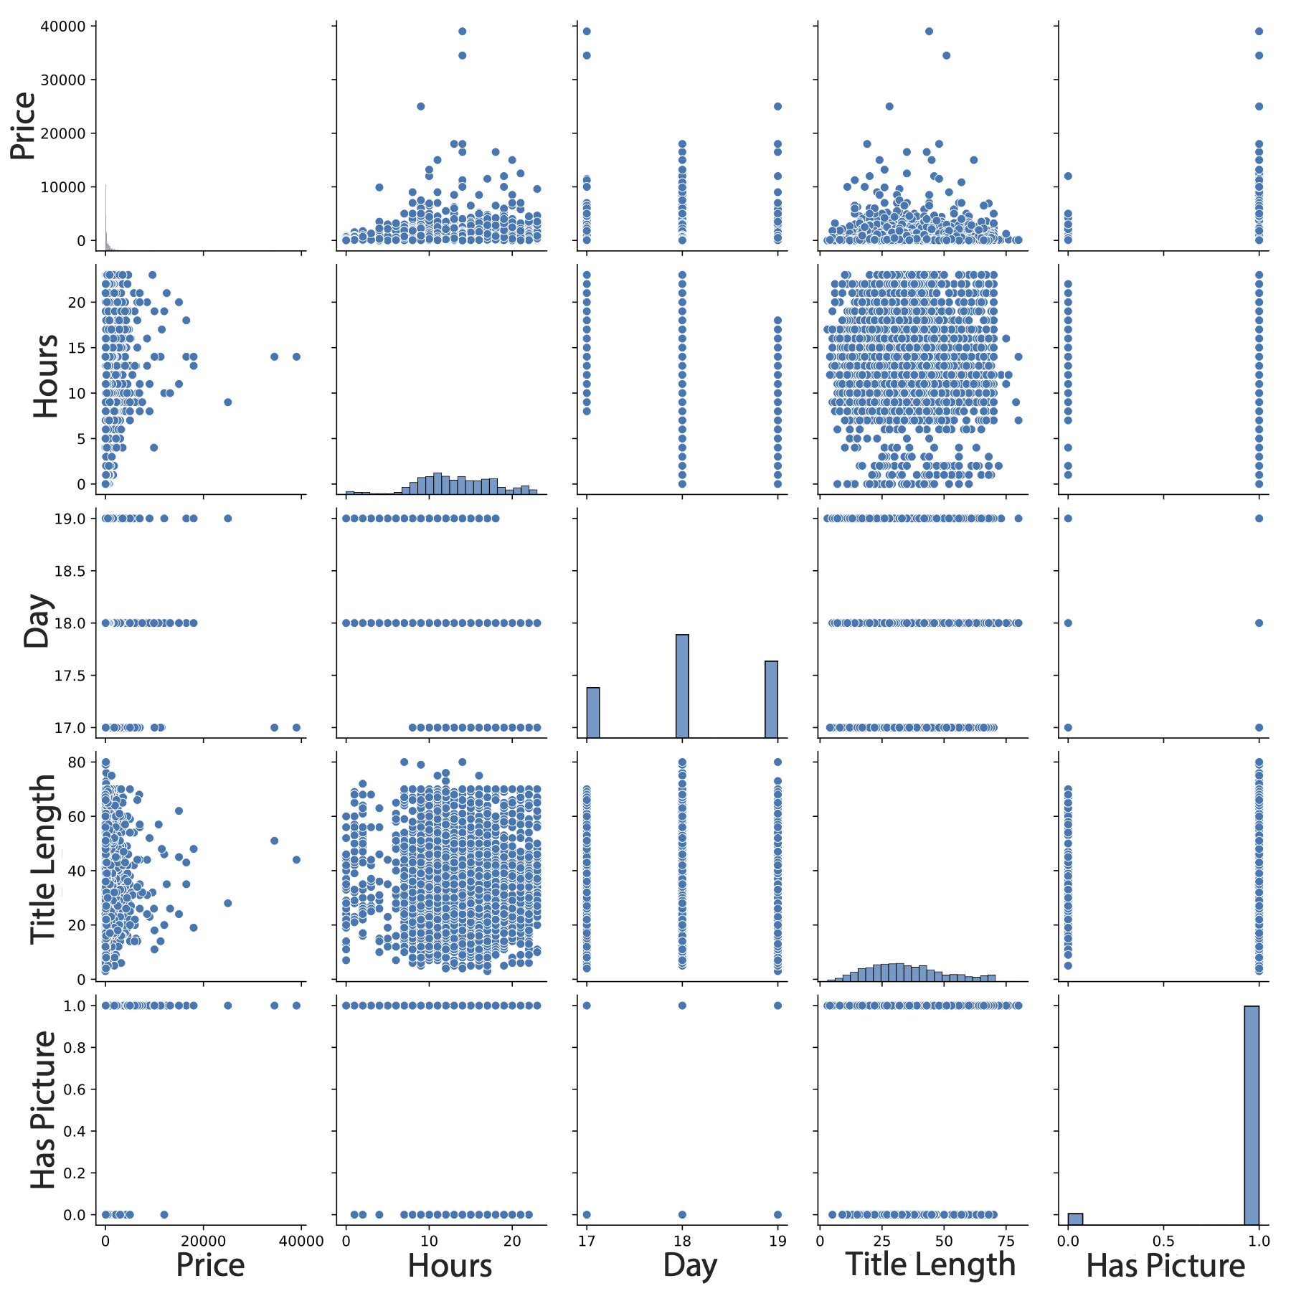

Slide 28
Linear vs Polynomial Model
Included 4 features in both models
Location was not able to be included in these two models
>200 locations
Can be subdivided into 6 regions

Slide 29
Linear vs Polynomial Model
Included 4 features in both models
Location was not able to be included in these two models
>200 locations
Can be subdivided into 6 regions
“Vanilla” Linear Model
Validation R² = -0.008

Slide 30
Linear vs Polynomial Model
Included 4 features in both models
Location was not able to be included in these two models
>200 locations
Can be subdivided into 6 regions
“Vanilla” Linear Model
Validation R² = -0.008
Polynomial Model
Validation R² = 0.003
Test R² = 0.002

Slide 31
RMSE and MAE
Median = $200
Mean = 685
Median = $200
Mean = $685

Slide 32
RMSE and MAE
Median = $200
Mean = 685
Median = $200
MAE = $781
Mean = $685

Slide 33
RMSE and MAE
Median = $200
Mean = 685
Median = $200
MAE = $781
RMSE = $2,039
Mean = $685

Slide 34
What have we learned?

Slide 35
What have we learned?
What not to worry about

Slide 36
What have we learned?
What not to worry about
Hour of the day

Slide 37
What have we learned?
What not to worry about
Hour of the day
Lowest price items late night-early morning

Slide 38
What have we learned?
What not to worry about
Hour of the day
Lowest price items late night-early morning
Day of the week

Slide 39
What have we learned?
What not to worry about
Hour of the day
Lowest price items late night-early morning
Day of the week
Length of the title

Slide 40
What have we learned?
What can we still learn?
What not to worry about
Hour of the day
Lowest price items late night-early morning
Day of the week
Length of the title

Slide 41
What have we learned?
What can we still learn?
What not to worry about
Hour of the day
Lowest price items late night-early morning
Day of the week
Length of the title
Importance of location

Slide 42
What have we learned?
What can we still learn?
What not to worry about
Hour of the day
Lowest price items late night-early morning
Day of the week
Length of the title
Importance of location
6 regions separated by Craigslist

Slide 43
What have we learned?
What can we still learn?
What not to worry about
Hour of the day
Lowest price items late night-early morning
Day of the week
Length of the title
Importance of location
6 regions separated by Craigslist
Merge with Census data (2020/2021 census data coming out soon)

Slide 44
What have we learned?
What can we still learn?
What not to worry about
Hour of the day
Lowest price items late night-early morning
Day of the week
Length of the title
Importance of location
6 regions separated by Craigslist
Merge with Census data (2020/2021 census data coming out soon)
Variance in instruments

Slide 45
Fin

Slide 46
